Slide 1
Frontiers of AI Accelerators: Technologies, Circuits and Applications II
HW/SW Co-Exploration to Enable Automated Machine Learning System Design
Weiwen Jiang
wjiang8@gmu.edu
https://jqub.ece.gmu.edu

Slide 2
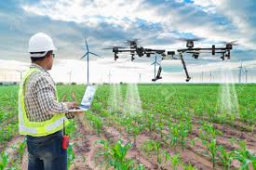
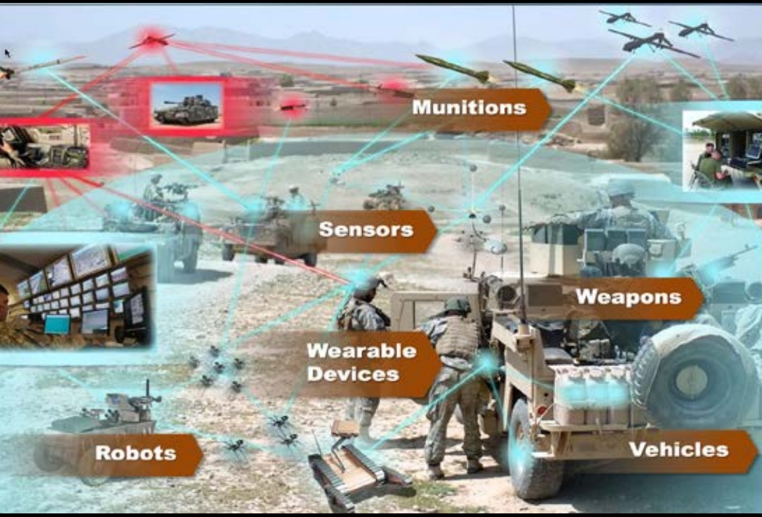

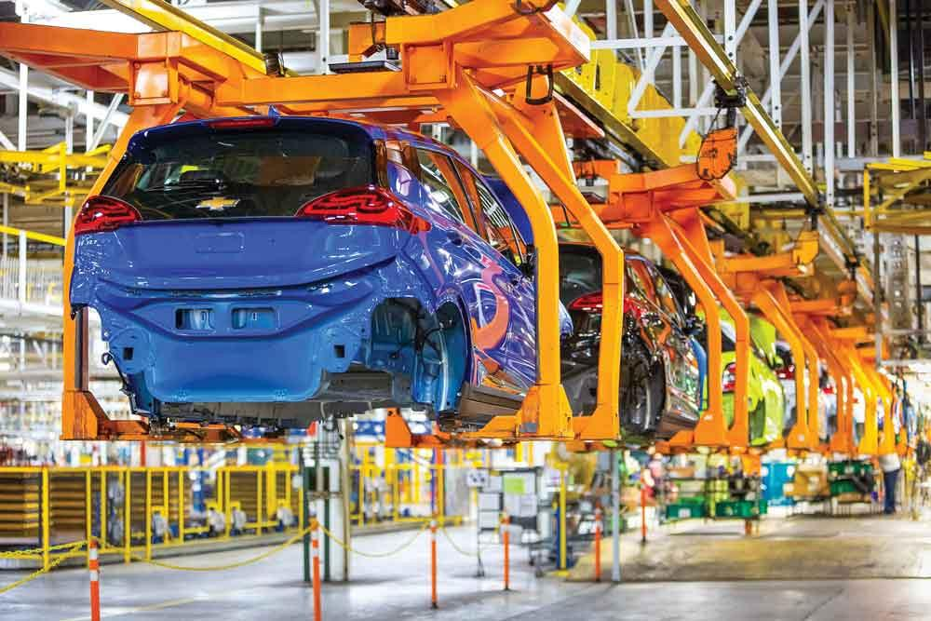

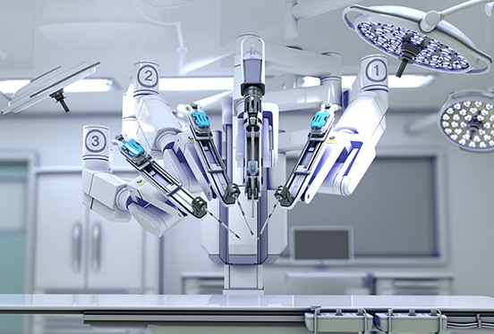

Today, AI is Going to Every Embedded Computing Hardware
Agriculture
Military
Power System
Manufacture
……
Education
Medical Operation
Finance
Notes:
Today, we expect that the computing can not only do the repeated jobs but also do these jobs smartly. That is, we would like to integrate intelligence in these systems to further reduce the burden on human beings.

Slide 3



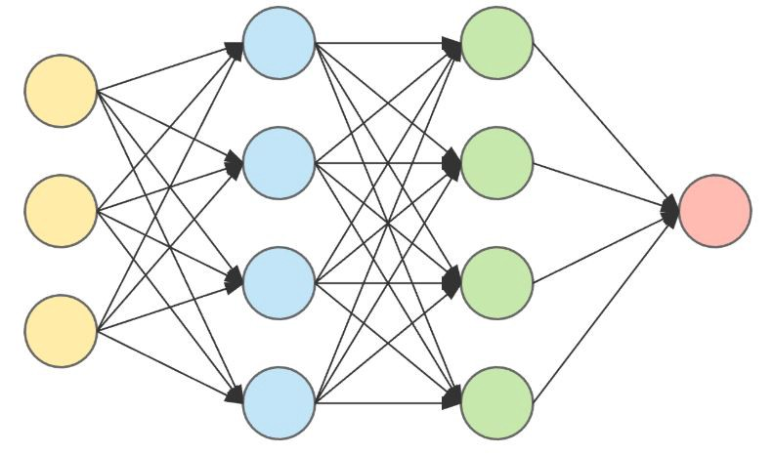
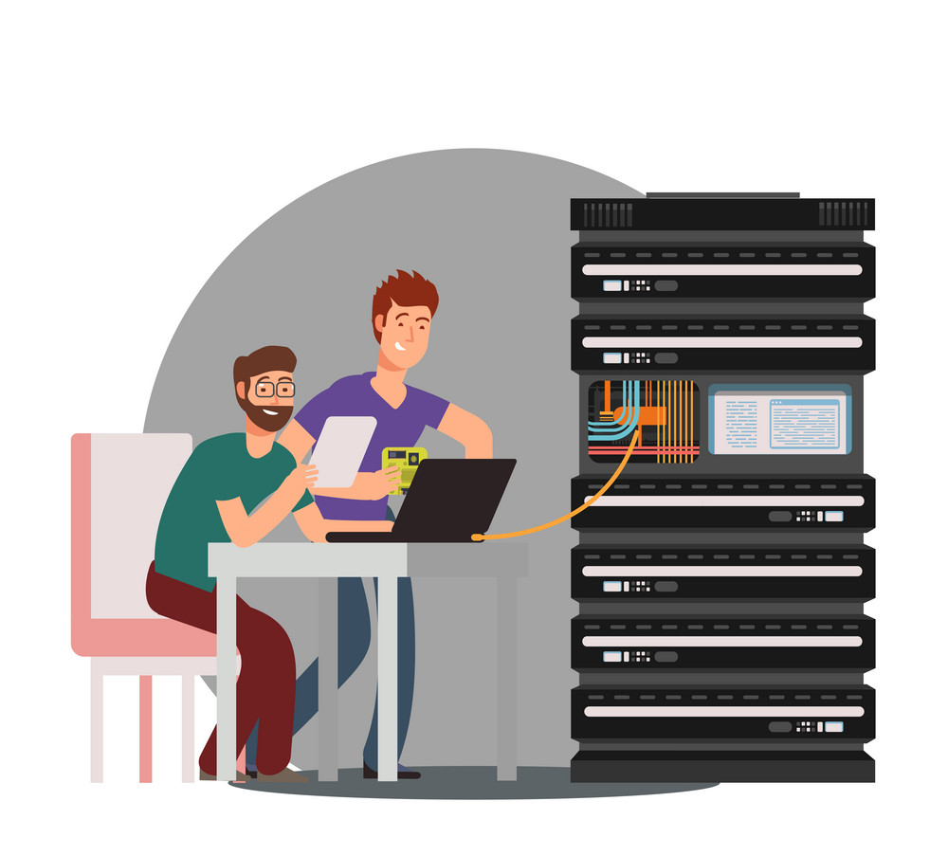


Bottleneck in Applying ML for Specific Applications
Manually Design Neural Network:
Requires expertise from different domains
Collaboration of these experts is difficult
Large human labor
Long launch time…
Computer Vision Experts
✔
Ski
Computer Scientist
Data Scientist
3

Slide 4

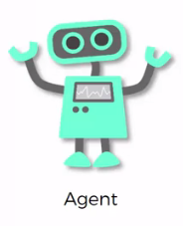

AutoML is a Promising Solution
Automated Design Neural Network:
Replace exerts by using automated optimization approaches
Release the labor from experts
Short launch time
Action
Env.
e.g. Reinforcement Learning
Reward
Objective:
Maximize ML Performance
(e.g., Prediction Accuracy)
✔
Ski
4
Notes:
== Until now, everything seems to be great, and the above bottlenecks have been addressed by Auto ML approaches and techniques.
Can you think about anything missed, or any problems? especially in these two applications about ML in Medical Imaging (Dermatology Diagnosis) and ML in Drug Discovery (Molecular Reaction and Toxic)

Slide 5
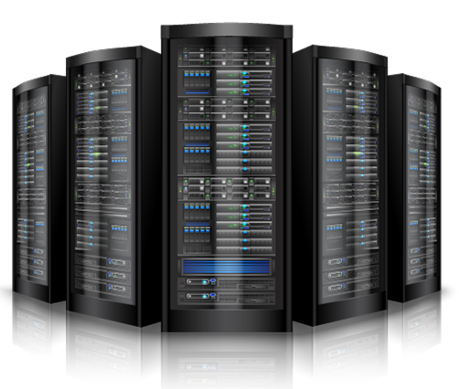
One Network Cannot Work for All Platforms
Cloud / Server
Unlimited Resource
Maximizing Accuracy
AlexNet, VGGNet, ResNet, …
ResNet
AlexNet
NASNet
Mobile Phones
Fixed Hardware
Accuracy v.s. Latency
MnasNet, ProxylessNAS, …
MobileNet
MnasNet
FBNet
ProxylessNAS
Hardware Accelerators (e.g., FPGA)
Hardware Design Flexibility
Accuracy, Latency, and Energy
FNAS, SkyNet, EDDNet…
SkyNet
EDDNet
FNAS
5
Notes:
Now, I will show the importance of the second level of optimization. As shown in this slides, the intelligence is widely required in different computing platforms, such as cloud computing, mobile phones, and customized hardware accelerators. Different computing platforms have different requirements.
(click) For instance, the cloud computing have enough computing resources and the objective is to maximize accuracy.
(cick) For mobile phones, it has fixed hardware and a tradeoff between accuracy and latency needs to be made.
(click) For customized hardware, it further has hardware design flexibilities and it is expected to achieve better t’radeoffs among accuracy, timing performance and energy efficiency.
As a result, no uniform neural network architecture can work for all computing platforms. The existing works have explored different neural networks for different platforms, as shown in this slides.

Slide 6


Problem: Datasets/Applications, Hardware, and Neural Networks
Datasets / Applications
Neural Networks
Hardware Platforms
FPGA
6
Notes:
To better understand the following topics, now, let’s see the fundamental problem for the automation of AI system. As shown in this slides, we are given datasets, a specific hardware, and a search space of neural networks where each circle represent one potential neural network. We need to identify a neural network architecture from the search space, such that both software and hardware can achieve high performance.

Slide 7
Outline
Background
A Quick Overview of The Road From Manual Design to AutoML
HW/SW Co-Exploration Framework
Motivation
Framework Overview and Details
Results
Follow-up Works and Conclusion

Slide 8
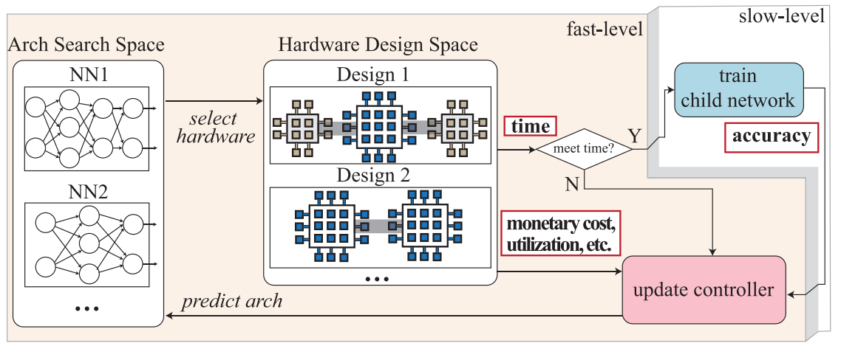
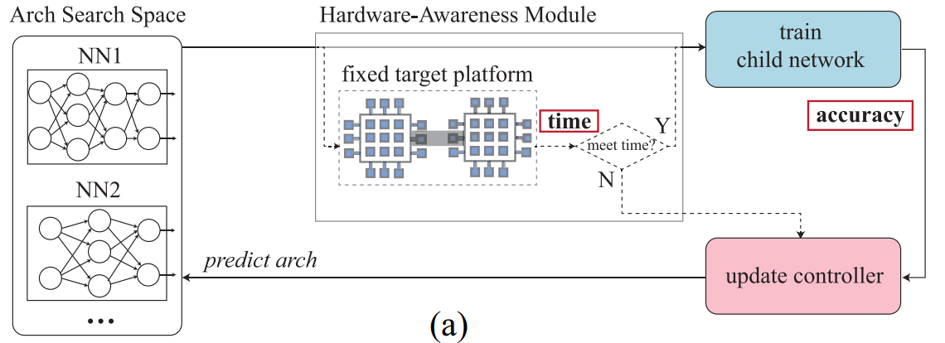
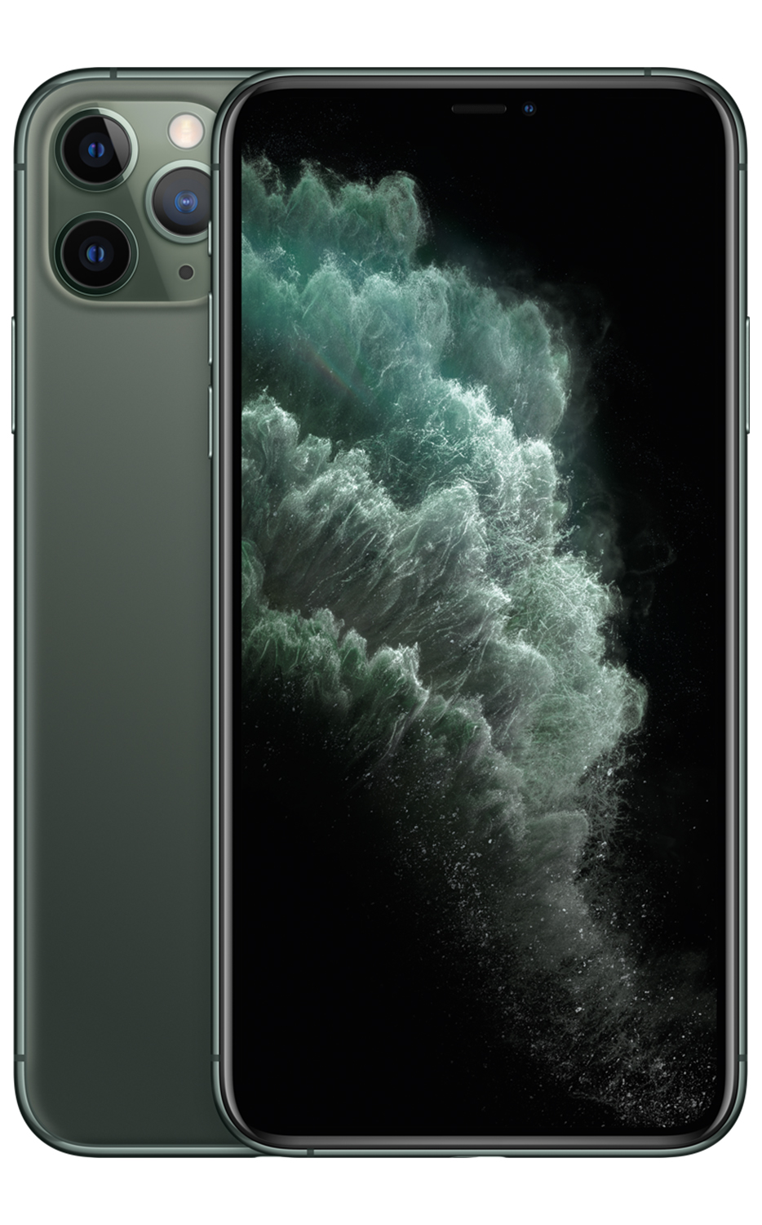
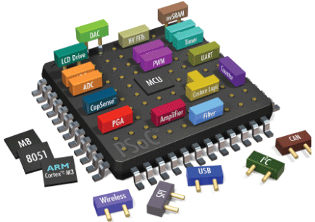
HW/SW Co-Exploration of Neural Architectures
2016 - Now
FNAS
HW/SW Co-Exploration
NANDS
NASAIC
NACIM
AlexNet
VGGNet
Neural Archi. Search (RL-based)
DARTS
ZFNet
GoogleNet
MnasNet
from Google
proxylessNAS
from MIT
FBNet from UCB FB
FPGA/DNN (UIUC)
SkyNet
HW/CNN (Samsung)
EDD Net
2012
2013
2014
2015
2016
2017
2018
2019
Aug. 2019
2020
2021
I. Human Invented
II. NAS and HW-Aware NAS
III. HW/SW Co-exploration
Sample architecture NN with probability p
Controller (RNN)
Train from Scratch
To Obtain Accuracy A
Cloud/HPC
Mobile (Edge)
MCU (Tiny)
Update controller by A
FPGA
ASIC
Computing-in-Mem
FPGA
ASIC
Network-on Chip
HW-aware NAS
HW/SW Co-Exploration of Neural Architectures
Neural Architecture Search (NAS)
Notes:
Jan 2019 FNAS --(Ours)
April 2019 FPGA/DNN – UIUC
Aug 2019 HW/SW Co-exploration (Ours)
September2019 SkyNet -- U.S. National Security Agency
Dec 2019 NANDS – (Ours) – ASP-DAC20
Jan 2020 NASAIC -- Ours）-- DAC 2020
May2020 EDD Net -- Efficient Differentiable DNN Architecture and Implementation Co-search for Embedded AI Solutions

Slide 9
Outline
Background
A Quick Overview of The Road From Manual Design to AutoML
HW/SW Co-Exploration Framework
Motivation
Framework Overview and Details
Results
Follow-up Works and Conclusion

Slide 10
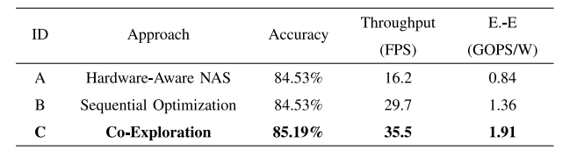
Motivation
Hardware-Aware NAS (Fixed HW)
Find network N under fixed HW H
TABLE I
ON CIFAR-10 AND XILINX XC7Z015 FPGA: COMPARISONS OF THREE NEURAL ARCHITECTURE AND HARDWARE DESIGN PAIRS IN ACCURACY, THROUGHPUT, AND ENERGY EFFICIENCY (E.-E): A) OPTIMAL ARCHITECTURE ON A FIXED HARDWARE IMPLEMENTATION THROUGH HARDWARE-AWARE NAS; B) THE SAME ARCHITECTURE BUT WITH FURTHER FPGA OPTIMIZATION; AND C) A JOINTLY OPTIMIZED NEURAL ARCHITECTURE AND FPGA IMPLEMENTATION THROUGH OUR CO-EXPLORATION.
Sequential Optimization:
Find network N under fixed HW H
Optimize HW H for N
Co-Exploration:
Optimize N and H in one loop
0.66% Accuracy Gain
2.19X and 1.20X Throughput Gain
2.27X and 1.40X Energy Efficiency
How to Co-Explore?
HW and Network Optimization are Coupled with Each Other
Notes:
Jan 2019 FNAS --(Ours)
April 2019 FPGA/DNN – UIUC
Aug 2019 HW/SW Co-exploration (Ours)
September2019 SkyNet -- U.S. National Security Agency
Dec 2019 NANDS – (Ours) – ASP-DAC20
Jan 2020 NASAIC -- Ours）-- DAC 2020
May2020 EDD Net -- Efficient Differentiable DNN Architecture and Implementation Co-search for Embedded AI Solutions

Slide 11

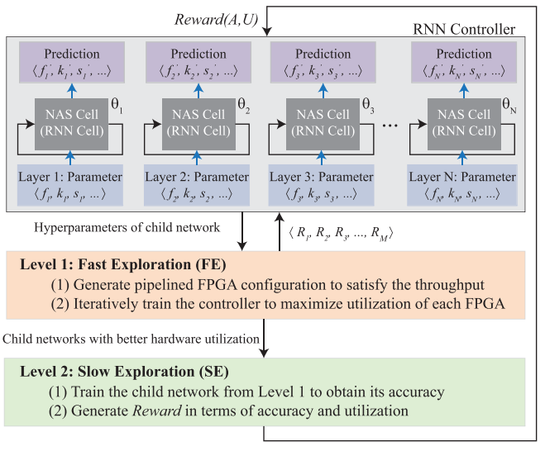

Framework: Optimizing Network Architecture and HW Design in One Loop
Optimization Controller
Controller iteratively selects solution from the search space for evaluation
Search Space
SW
HW
Controller is evolved using the evaluation results from previous iteration.
Evaluator
Notes:
Jan 2019 FNAS --(Ours)
April 2019 FPGA/DNN – UIUC
Aug 2019 HW/SW Co-exploration (Ours)
September2019 SkyNet -- U.S. National Security Agency
Dec 2019 NANDS – (Ours) – ASP-DAC20
Jan 2020 NASAIC -- Ours）-- DAC 2020
May2020 EDD Net -- Efficient Differentiable DNN Architecture and Implementation Co-search for Embedded AI Solutions

Slide 12
Framework: Optimizing Network Architecture and HW Design in One Loop
Controller: Reinforcement learning based optimizer
Search Space
SW
HW
Evaluator
Notes:
Jan 2019 FNAS --(Ours)
April 2019 FPGA/DNN – UIUC
Aug 2019 HW/SW Co-exploration (Ours)
September2019 SkyNet -- U.S. National Security Agency
Dec 2019 NANDS – (Ours) – ASP-DAC20
Jan 2020 NASAIC -- Ours）-- DAC 2020
May2020 EDD Net -- Efficient Differentiable DNN Architecture and Implementation Co-search for Embedded AI Solutions

Slide 13
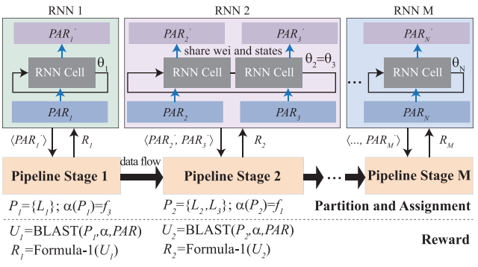
Framework: Optimizing Network Architecture and HW Design in One Loop
Search Space Exploration:
Network Hyperparameters (SW)
Partition and Assignment (HW)
Controller
Evaluator
Notes:
Jan 2019 FNAS --(Ours)
April 2019 FPGA/DNN – UIUC
Aug 2019 HW/SW Co-exploration (Ours)
September2019 SkyNet -- U.S. National Security Agency
Dec 2019 NANDS – (Ours) – ASP-DAC20
Jan 2020 NASAIC -- Ours）-- DAC 2020
May2020 EDD Net -- Efficient Differentiable DNN Architecture and Implementation Co-search for Embedded AI Solutions

Slide 14
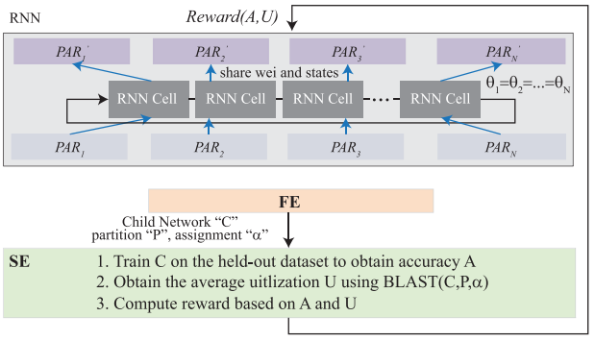
Framework: Optimizing Network Architecture and HW Design in One Loop
Evaluator:
Obtain Accuracy A and HW Utilization U
Generate Reward with A & U
Controller
Search Space
SW
HW
Notes:
Jan 2019 FNAS --(Ours)
April 2019 FPGA/DNN – UIUC
Aug 2019 HW/SW Co-exploration (Ours)
September2019 SkyNet -- U.S. National Security Agency
Dec 2019 NANDS – (Ours) – ASP-DAC20
Jan 2020 NASAIC -- Ours）-- DAC 2020
May2020 EDD Net -- Efficient Differentiable DNN Architecture and Implementation Co-search for Embedded AI Solutions

Slide 15
Framework: Optimizing Network Architecture and HW Design in One Loop
Controller iteratively selects solution from the search space for evaluation
Controller is evolved using the evaluation results from previous iteration.
Notes:
Jan 2019 FNAS --(Ours)
April 2019 FPGA/DNN – UIUC
Aug 2019 HW/SW Co-exploration (Ours)
September2019 SkyNet -- U.S. National Security Agency
Dec 2019 NANDS – (Ours) – ASP-DAC20
Jan 2020 NASAIC -- Ours）-- DAC 2020
May2020 EDD Net -- Efficient Differentiable DNN Architecture and Implementation Co-search for Embedded AI Solutions

Slide 16
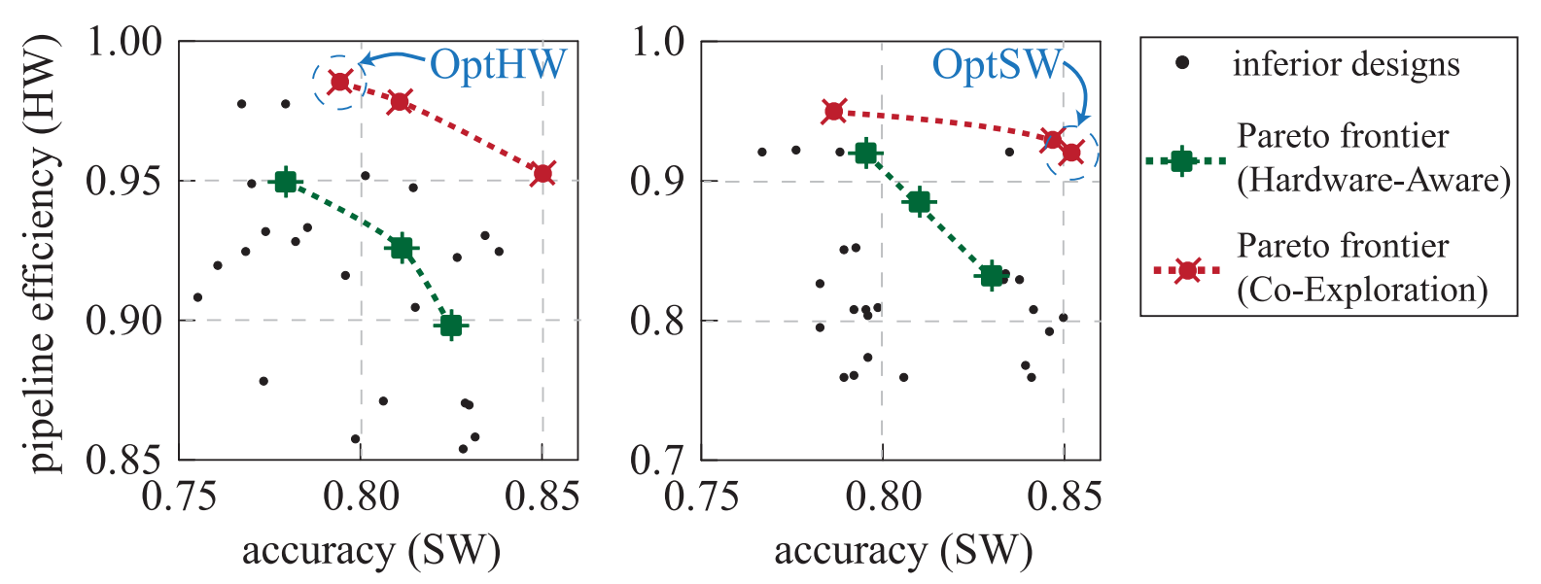
Results
At most 2 FPGAs
At most 3 FPGAs
Pareto Frontier between Accuracy and HW Efficiency can be Significantly Pushed Forward

Slide 17
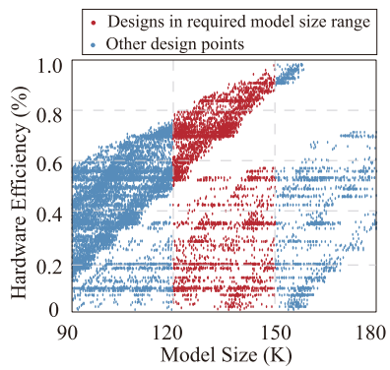
Results
Minimizing model size may not achieve the highest hardware efficiency

Slide 18
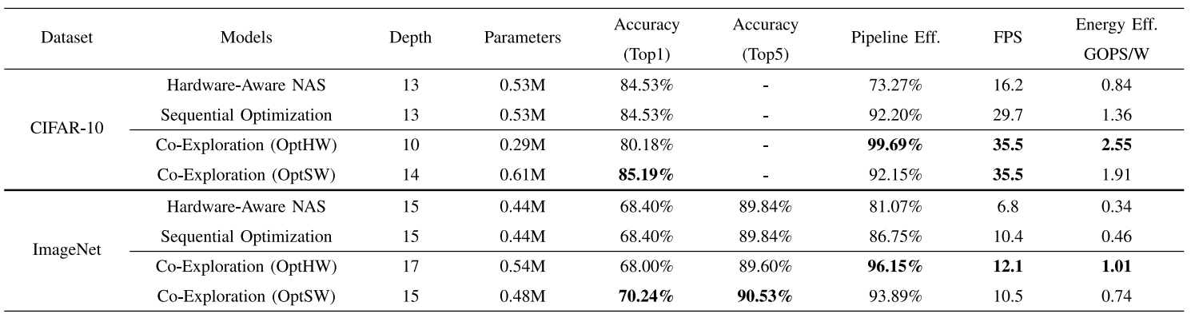
Results
Co-Exploration Outperform Competitors on Different Datasets

Slide 19
Outline
Background
A Quick Overview of The Road From Manual Design to AutoML
HW/SW Co-Exploration Framework
Motivation
Framework Overview and Details
Results
Follow-up Works and Conclusion

Slide 20
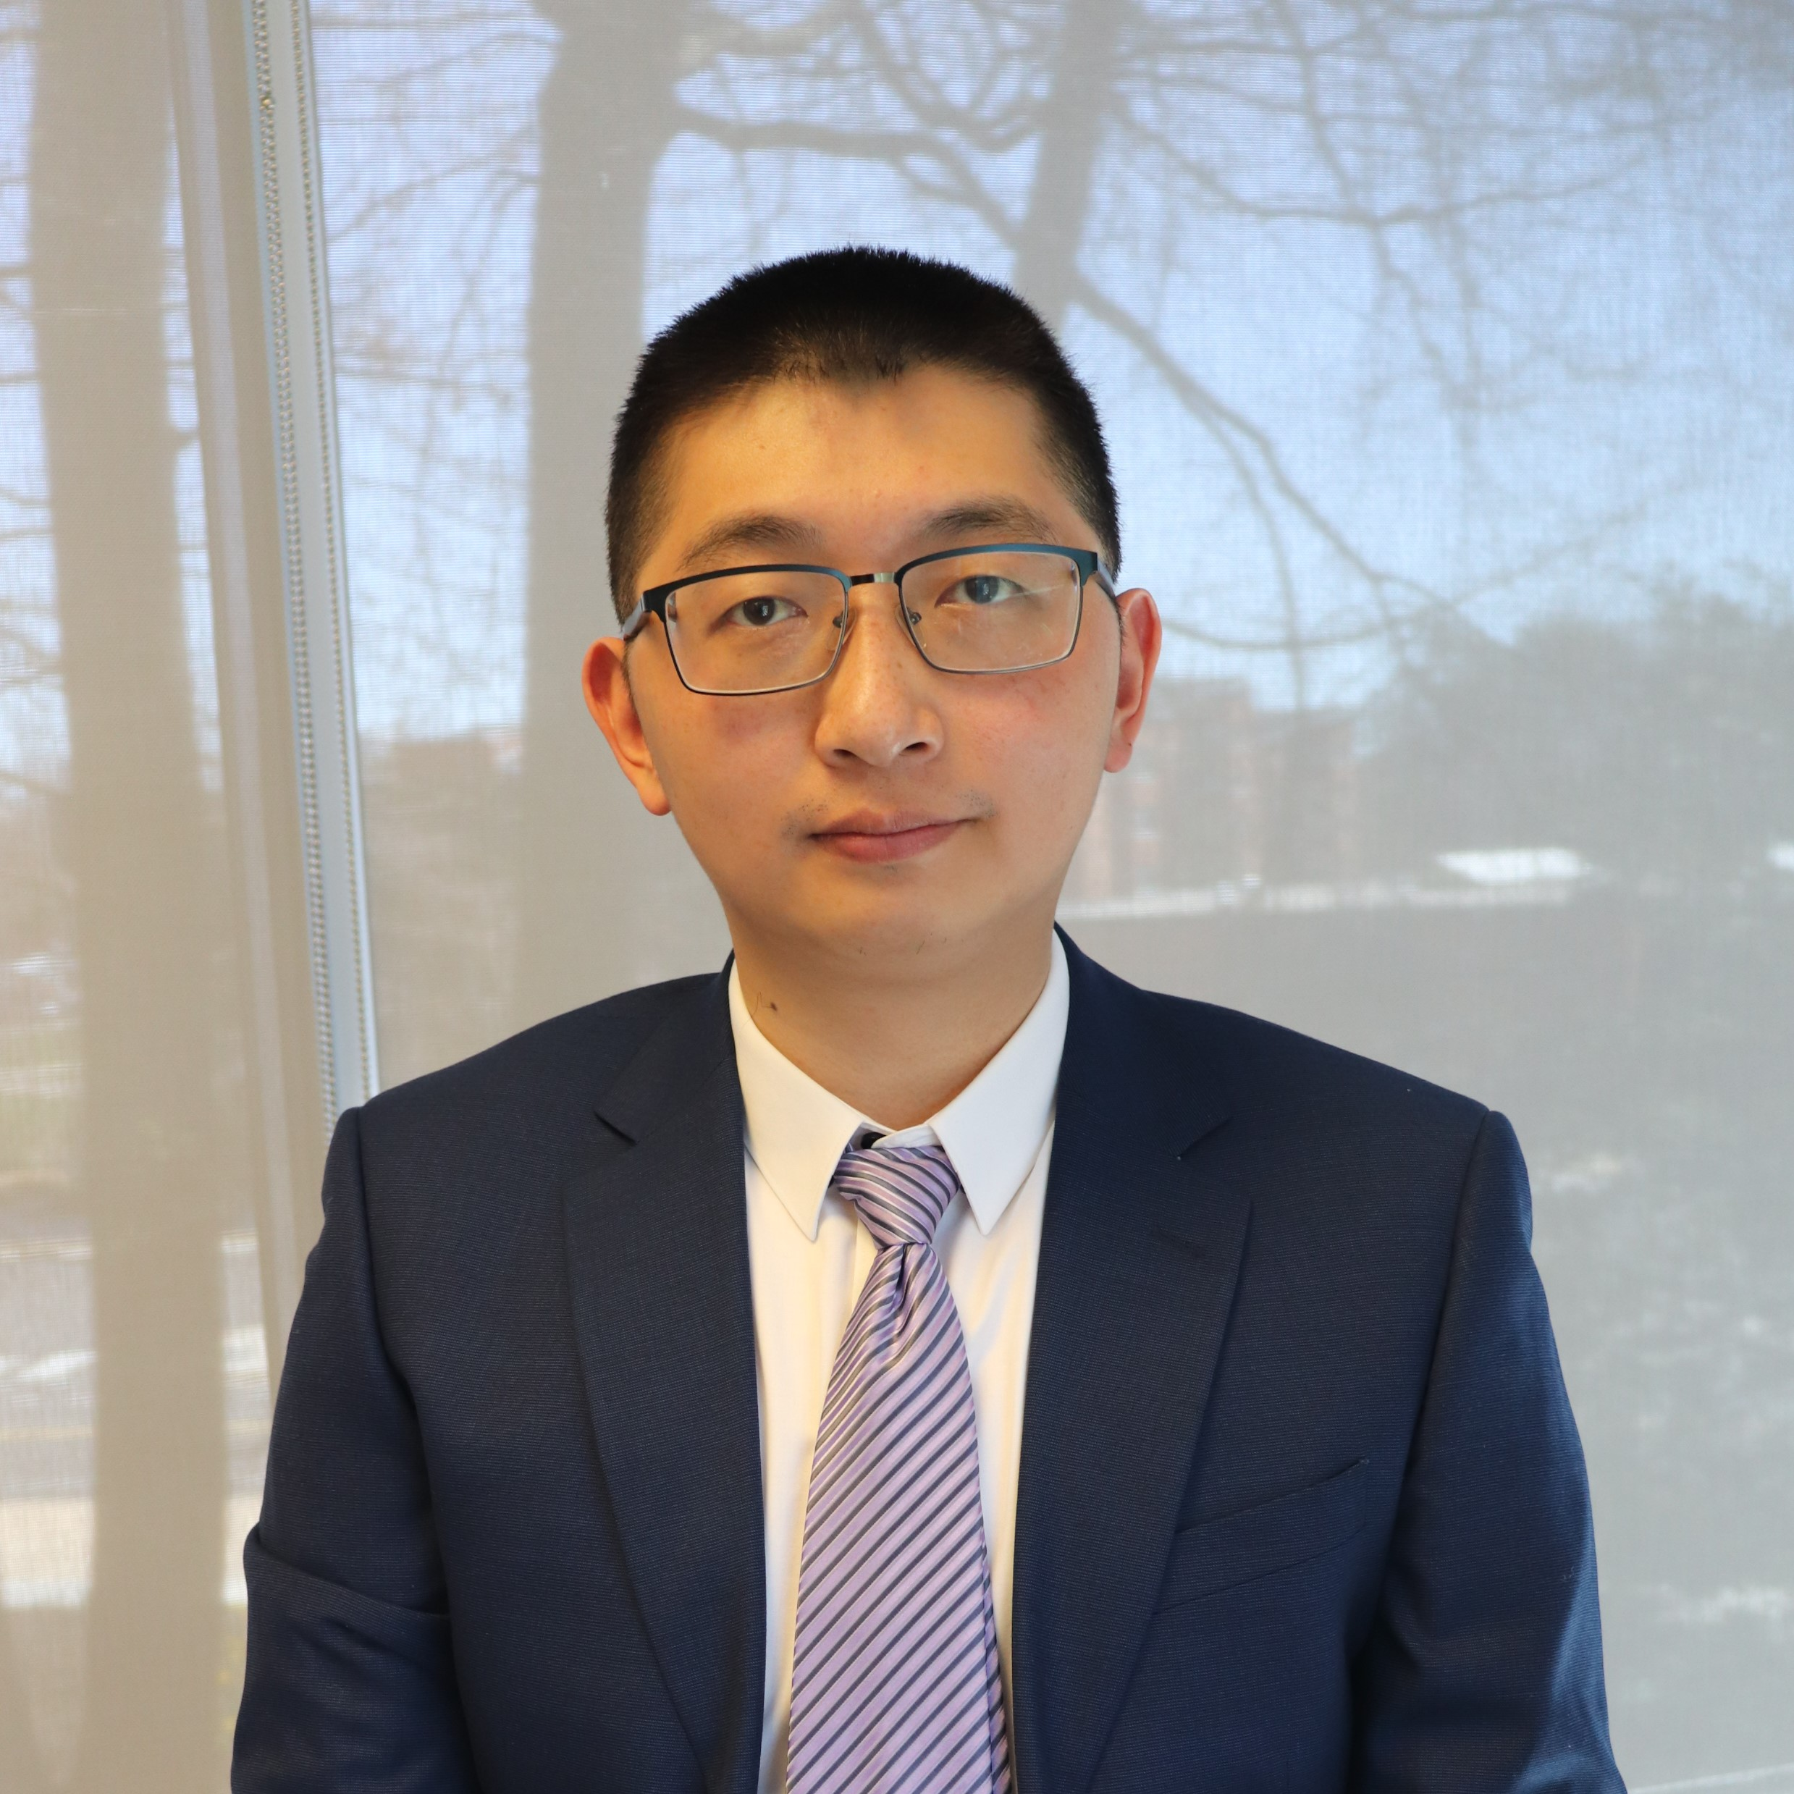
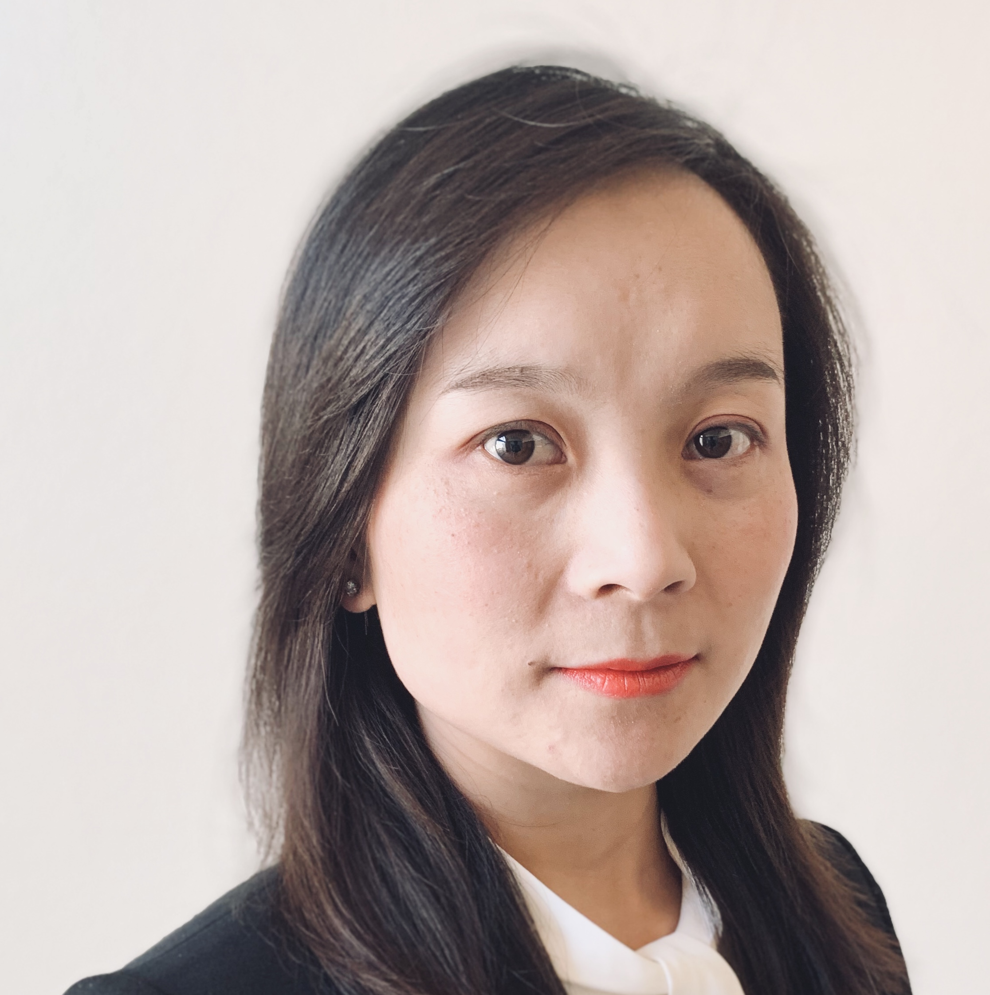
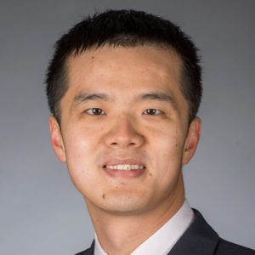
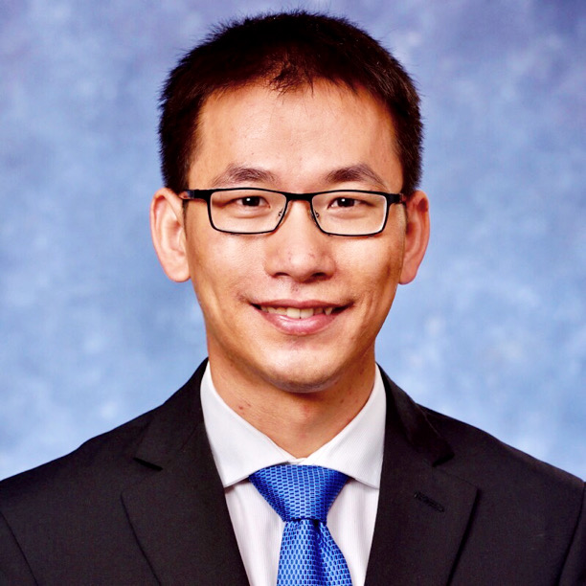




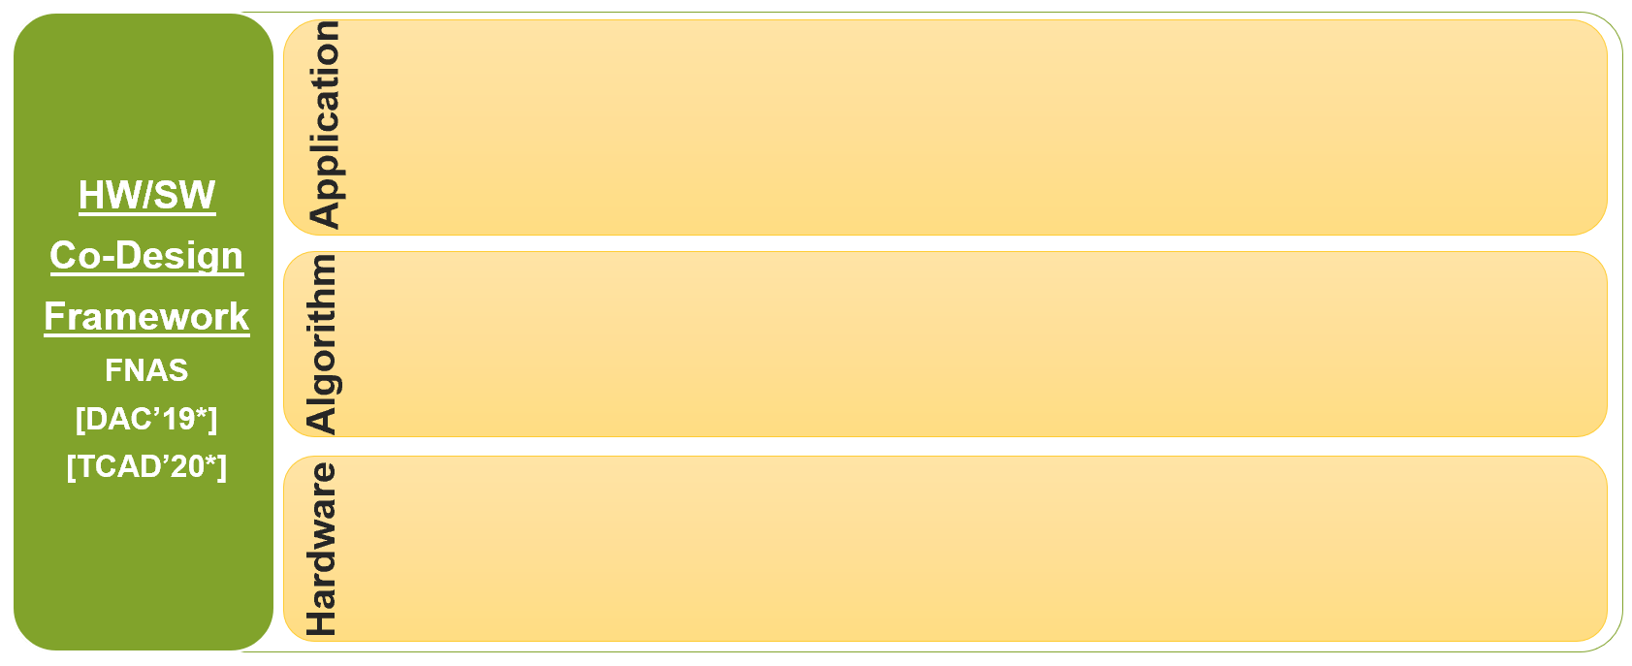

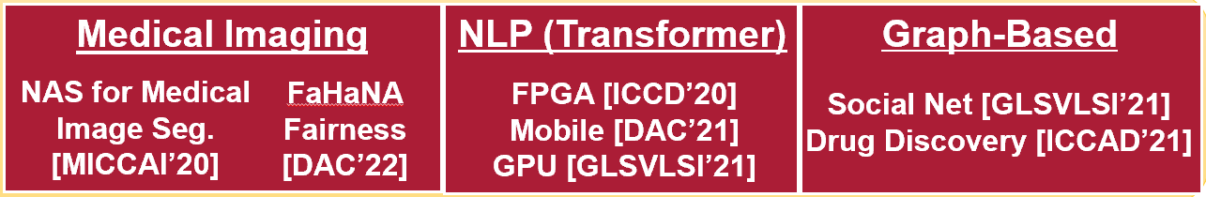
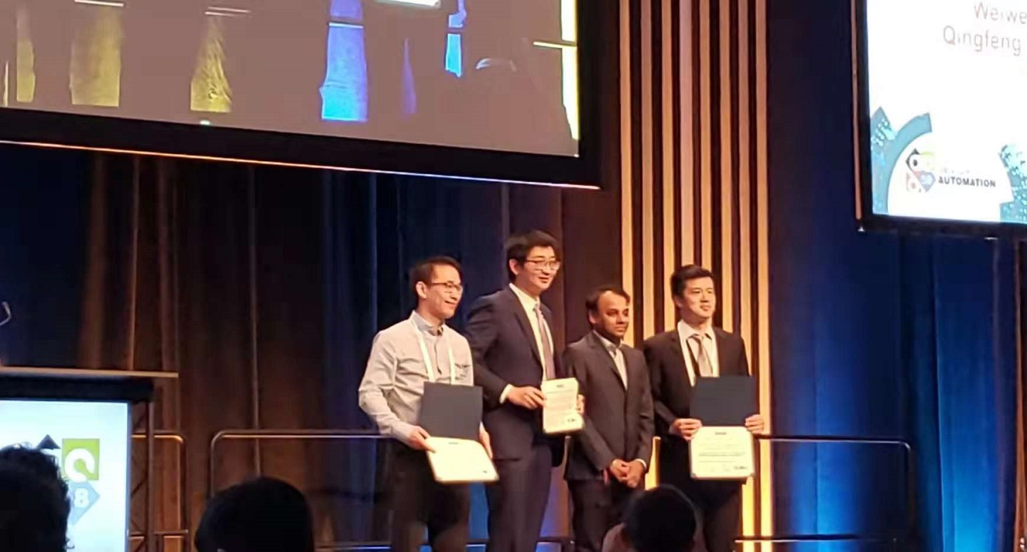
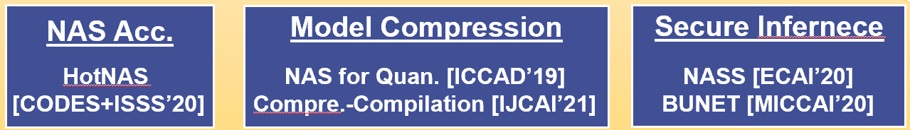
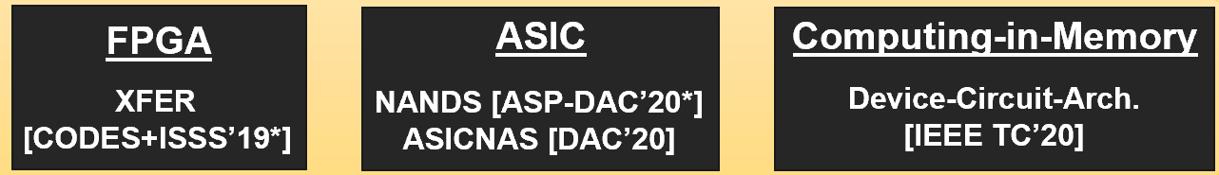



Design Stack Built By the Team
HW/SW Co-Design
Quantum Machine Learning
HW/SW Co-Design Stack using NAS
Best Paper Award:
Best Paper
Nominations:

Slide 21

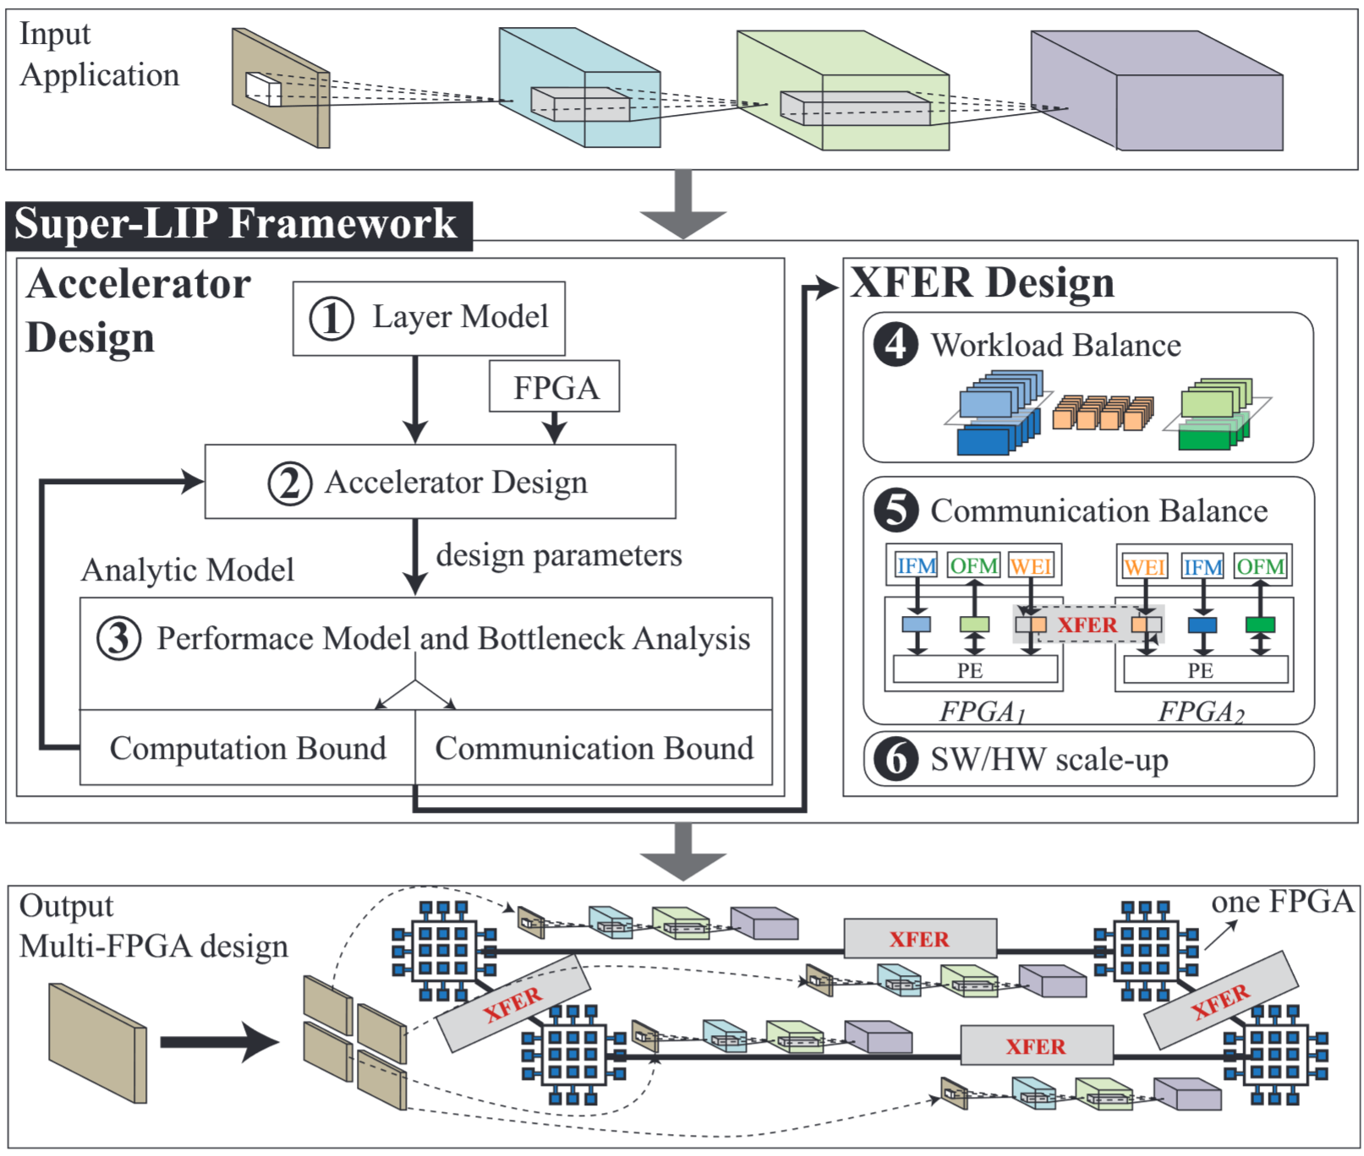
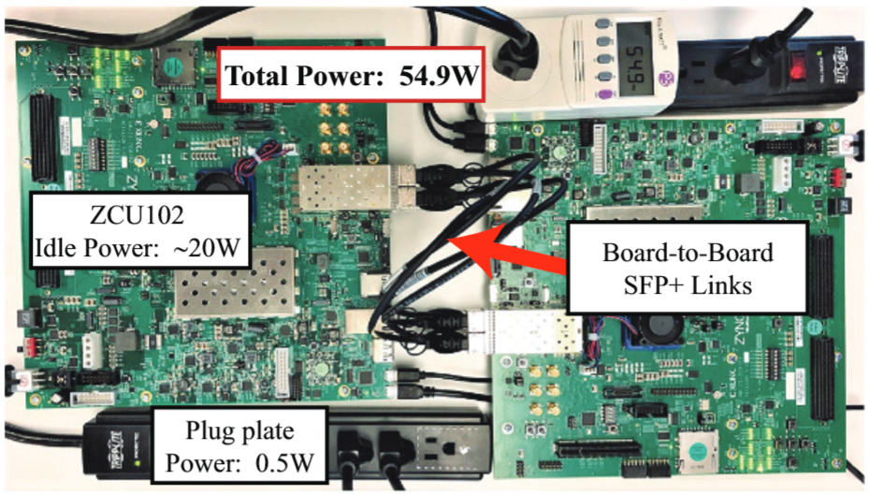
Co-Design NAS Full-Stack
Best Paper Nomination
XFER:
Neural Network Partition
Performance Model
Multiple FPGA
Load Balance
HW/SW
Co-Design
Framework
FNAS
[DAC’19*]
[TCAD’20*]
FPGA
ASIC
Computing-in-Memory
Hardware
Device-Circuit-Arch.
[IEEE TC’20]
XFER [CODES+ISSS’19*]
NANDS [ASP-DAC’20*]
ASICNAS [DAC’20]

Slide 22


Co-Design NAS Full-Stack
HW/SW
Co-Design
Framework
FNAS
[DAC’19*]
[TCAD’20*]
First HW/SW Co-Design
For ASICs with Huge
HW Design Space
ASINAS:
Multi-Tasks
Template-Based NAS
Heterogenous ASICs
FPGA
ASIC
Computing-in-Memory
XFER [CODES+ISSS’19*]
NANDS [ASP-DAC’20*]
ASICNAS [DAC’20]
Device-Circuit-Arch.
[IEEE TC’20]

Slide 23

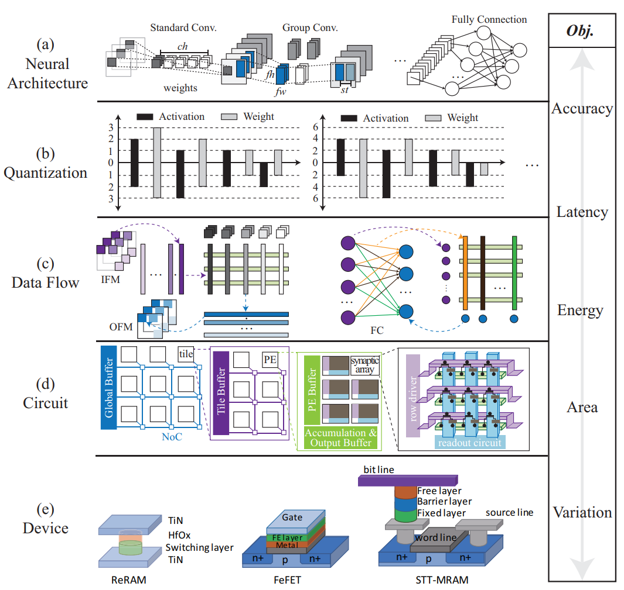
Co-Design NAS Full-Stack
First HW/SW Co-Design
For Computing-in-Memory
Accelerators with
Device Variation
HW/SW
Co-Design
Framework
FNAS
[DAC’19*]
[TCAD’20*]
NACIM:
Cross-layer Optimization
Multi-Object Optimization
CiM Accelerator
Device Variation
FPGA
ASIC
Computing-in-Memory
XFER [CODES+ISSS’19*]
NANDS [ASP-DAC’20*]
ASICNAS [DAC’20]
Device-Circuit-Arch.
[IEEE TC’20]

Slide 24
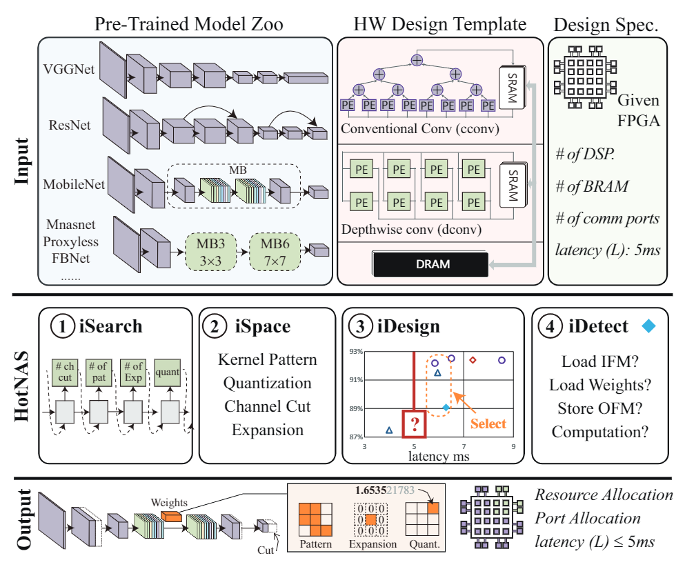
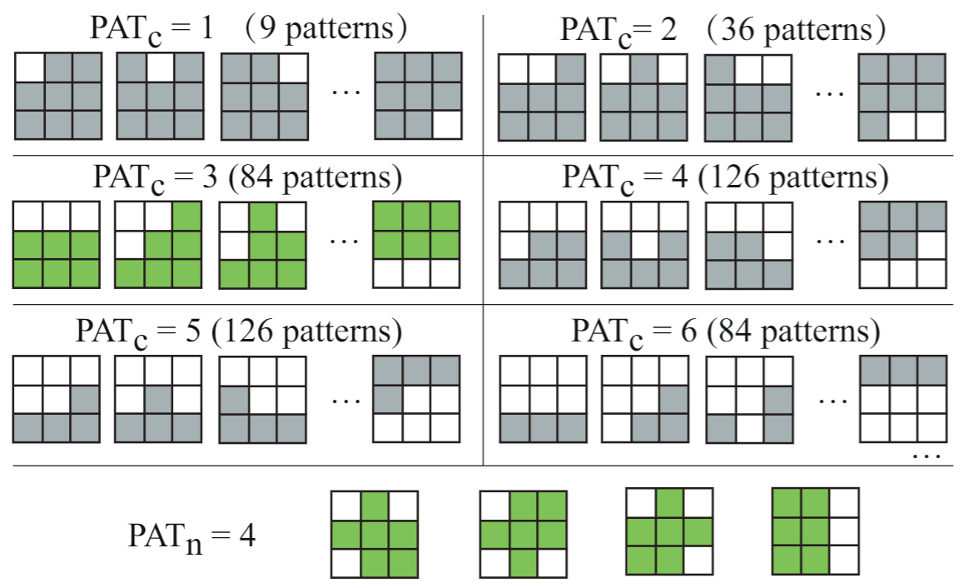
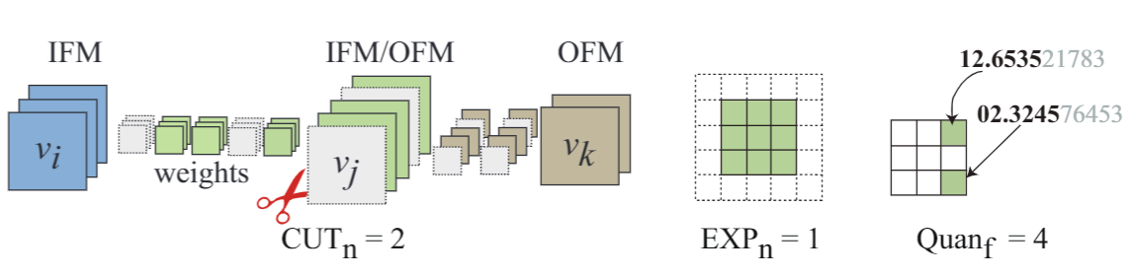
Co-Design NAS Full-Stack
NAS Acc.
Model Compression
Secure Infernece
Algorithm
HotNAS [CODES+ISSS’20]
NAS for Quan. [ICCAD’19]
Compre.-Compilation [IJCAI’21]
NASS [ECAI’20]
BUNET [MICCAI’20]
HW/SW
Co-Design
Framework
FNAS
[DAC’19*]
[TCAD’20*]
More than 200 → Less than 3 (GPU Hours) on ImageNet Dataset

Slide 25
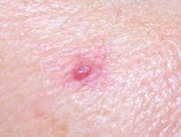
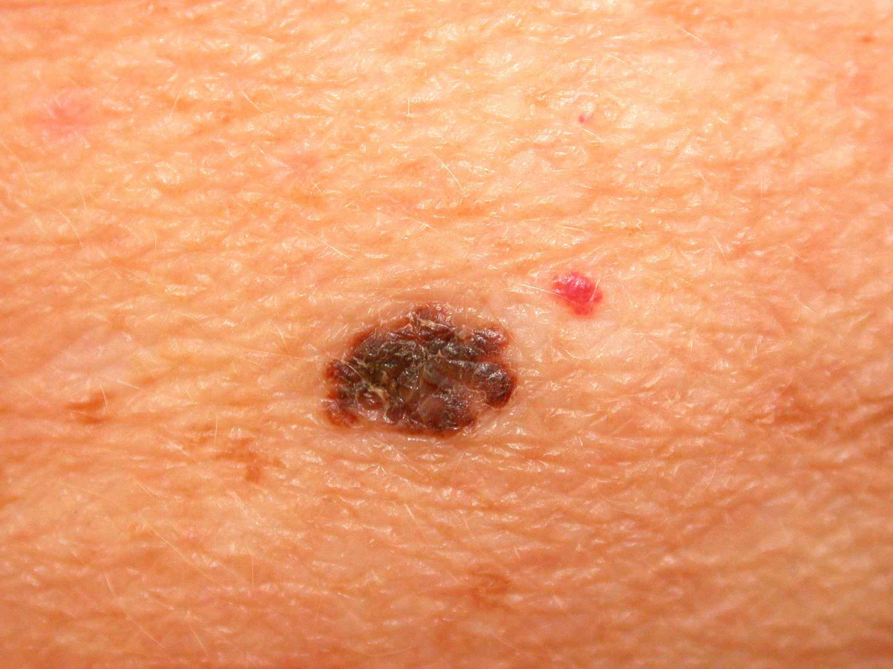
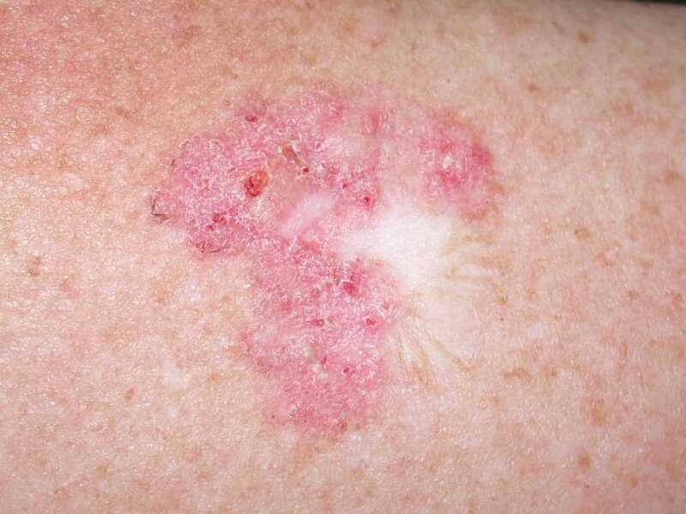

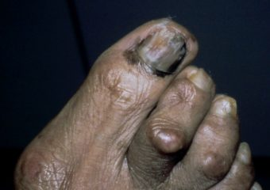
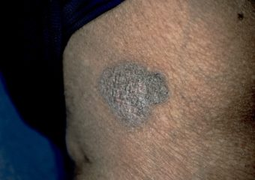

Co-Design NAS Full-Stack
Medical Imaging
NLP (Transformer)
Graph-Based
Application
NAS for Medical Image Seg.
[MICCAI’20]
FaHaNA
Fairness
[DAC’22]
FPGA [ICCD’20]
Mobile [DAC’21]
GPU [GLSVLSI’21]
Social Net [GLSVLSI’21]
Drug Discovery [ICCAD’21]
HW/SW
Co-Design
Framework
FNAS
[DAC’19*]
[TCAD’20*]
First Framework to Co-Optimize Accuracy and Fairness via NAS
Fairness
Vascular lesion
Melanoma
Basal cell carcinoma
Existing Networks
Light Skin
76.80%
Dark Skin
49.38%
DAC This Year!

Slide 26
Co-Design NAS Full-Stack
Medical Imaging
NLP (Transformer)
Graph-Based
Application
NAS for Medical Image Seg.
[MICCAI’20]
FaHaNA
Fairness
[DAC’22]
FPGA [ICCD’20]
Mobile [DAC’21]
GPU [GLSVLSI’21]
Social Net [GLSVLSI’21]
Drug Discovery [ICCAD’21]
HW/SW
Co-Design
Framework
FNAS
[DAC’19*]
[TCAD’20*]
NAS Acc.
Model Compression
Secure Infernece
Algorithm
HotNAS [CODES+ISSS’20]
NAS for Quan. [ICCAD’19]
Compre.-Compilation [IJCAI’21]
NASS [ECAI’20]
BUNET [MICCAI’20]
FPGA
ASIC
Computing-in-Memory
Hardware
Device-Circuit-Arch.
[IEEE TC’20]
XFER [CODES+ISSS’19*]
NANDS [ASP-DAC’20*]
ASICNAS [DAC’20]

Slide 27
Conclusion
The very first framework to conduct HW/SW co-exploration
Co-exploration can push forward Pareto frontier of accuracy vs. efficiency
Providing fundamentals of the co-design stack
We even apply the co-design philosophy to quantum machine learning, the initial work was published at Nature Communications

Slide 28
Reference
[1] W. Jiang, J. Xiong, and Y. Shi, A Co-Design Framework of Neural Networks and Quantum Circuits Towards Quantum Advantage, Nature Communications, Jan. 2021
[2] W. Jiang, B. Xie, C-C Liu and Y. Shi, Integrating Memristors and CMOS for Better AI, Nature Electronics, Sep. 2019
[3] Y. Ding, W. Jiang, Q. Lou, J. Liu, J. Xiong, X. Sharon Hu, X. Xu, and Y. Shi, Hardware Design and the Competency Awareness of a Neural Network, Nature Electronics, Aug. 2020
[4] W. Jiang, E. H.-M. Sha, X. Zhang, L. Yang, Q. Zhuge, Y. Shi and J. Hu, Achieving Super-Linear Speedup across Multi-FPGA for Real-Time DNN Inference, International Conference on Hardware/Software Co-design and System Synthesis CODE+ISSS), also appears at ACM Transactions on Embedded Computing Systems (TECS), NYC, New York, USA, Oct. 2019. (BEST PAPER NOMINATION)
[5] W. Jiang, E. H.-M. Sha, Q. Zhuge, L. Yang, H. Dong and X. Chen, On the Design of Minimal-Cost Pipeline Systems Satisfying Hard/Soft Real-Time Constraints, IEEE International Conference on Computer Design (ICCD2017@BOSTON) & IEEE Transactions on Emerging Topics in Computing (TETC), Jan. 2018. (BEST PAPER AWARD)
[6] W. Jiang, L. Yang, E. H.-M. Sha, Q. Zhuge, S. Gu, S. Dasgupta, Y. Shi and J. Hu, Hardware/Software Co-Exploration of Neural Architectures, IEEE Transactions on Computer-Aided Design of Integrated Circuits and Systems (TCAD), Accepted, 2020.
[7] W. Jiang, E. H.-M. Sha, Q. Zhuge, L. Yang, X. Chen, and J. Hu, Heterogeneous FPGA-based Cost-Optimal Design for Timing-Constrained CNNs, International Conference on Compilers, Architecture, and Synthesis for Embedded Systems (CASES), also appears at IEEE Transactions on Computer-Aided Design of Integrated Circuits and Systems (TCAD), Torino, Italy, Oct. 2018.
[8] W. Jiang, E. H.-M. Sha, X. Chen, L. Yang, L. Zhou and Q. Zhuge, Optimal Functional-Unit Assignment for Heterogeneous Systems under Timing Constraint, IEEE Transactions on Parallel and Distributed Systems (TPDS), 28(9), 2567-2580, 2017.
28
Notes:
Here is the list of my journal publications, including nature electionics, nature communications, and several IEEE and ACM transactions papers.

Slide 29
Reference
[9] W. Jiang, E. H.-M. Sha, Q. Zhuge, L. Yang, X. Chen, and J. Hu, On the Design of Time-Constrained and Buffer-Optimal Self-Timed Pipelines, IEEE Transactions on Computer-Aided Design of Integrated Circuits and Systems (TCAD), Accepted, 2018.
[10] W. Jiang, L. Yang, S. Dasgupta, J. Hu and Y. Shi, Standing on the Shoulders of Giants: Hardware and Neural Architecture Co-Search with Hot Start, International Conference on Hardware/Software Co-design and System Synthesis CODE+ISSS), also appears at IEEE Transactions on Computer-Aided Design of Integrated Circuits and Systems (TCAD), Virtual, 2020.
[11] W. Jiang, Q. Lou, Z. Yan, L. Yang, J. Hu, X. S. Hu and Y. Shi, Device-Circuit-Architecture Co-Exploration for Computing-in-Memory Neural Accelerators, IEEE Transactions on Computers (TC), Accepted, 2020.
[12] E. H.-M. Sha, W. Jiang, H. Dong, Z. Ma, R. Zhang, X. Chen and Q. Zhuge, Towards the Design of Efficient and Consistent Index Structure with Minimal Write Activities for Non-Volatile Memory, IEEE Transactions on Computers (TC), 67(3), 432-448, 2018.
[13] W. Liu, L. Yang, W. Jiang, L. Feng, N. Guan, W. Zhang, and N. Dutt, Thermal-aware Task Mapping on Dynamically Reconfigurable Network-on-Chip based Multiprocessor System-on-Chip, IEEE Transactions on Computers (TC), Accepted, 2018.
[14] L. Yang, W. Liu, W. Jiang, M. Li, P. Chen and E. H.-M. Sha, FoToNoC: A Folded Torus-Like Network-on-Chip based Many-Core Systems-on-Chip in the Dark Silicon Era, IEEE Transactions on Parallel and Distributed Systems (TPDS), 28(7), 1905-1918, 2017.
[15] E. H.-M. Sha, X. Chen, Q. Zhuge, L. Shi and W. Jiang, A New Design of In-Memory File System Based on File Virtual Address Framework, IEEE Transactions on Computers (TC), 65(10), 2959-2972, Oct. 2016. (Editor’s pick of the year)
29

Slide 30
Reference
[16] W. Jiang, J. Xiong, and Y. Shi, When Machine Learning Meets Quantum Computers: A Case Study," in Proc. of IEEE/ACM Asia and South Pacific Design Automation Conference (ASP-DAC), 2021 (Invited Paper)
[17] W. Jiang, X. Zhang, E. H.-M. Sha, L. Yang, Q. Zhuge, Y. Shi, and J. Hu, Accuracy vs. Efficiency: Achieving Both through FPGA-Implementation Aware Neural Architecture Search, Design Automation Conference (DAC), 2019 (BEST PAPER NOMINATION)
[18] L. Yang, W. Jiang, W. Liu, E. H.-M. Sha, Y. Shi and J. Hu, Co-Exploring Neural Architecture and Network-on-Chip Design for Real-Time Artificial Intelligence, Proc. Asia and South Pacific Design Automation Conference (ASP-DAC), Beijing, Jan. 2020. (BEST PAPER NOMINATION)
[19] L. Yang, Z. Yan, M. Li, H. Kwon, L. Lai, T. Krishana, V. Chandra, W. Jiang, and Y. Shi, Co-Exploration of Neural Architectures and Heterogeneous ASIC Accelerator Designs Targeting Multiple Tasks, Design Automation Conference (DAC), 2020.
[20] Q. Lu, W. Jiang, X. Xiao, J. Hu and Y. Shi, On Neural Architecture Search for Resource-Constrained Hardware Platforms, Proc. IEEE/ACM International Conference On Computer-Aided Design (ICCAD), Westminster, CO, 2019.
[21] B. Song, W. Jiang, Q. Lu, Y. Shi and T. Sato, NASS: Optimizing Secure Inference via Neural Architecture Search, Proc. European Conference on Artificial Intelligence (ECAI), Santiago de Compostela, June. 2020.
[22] W. Jiang, E. H.-M. Sha, Q. Zhuge, H. Dong and X. Chen, Optimal Functional Unit Assignment and Voltage Selection for Pipelined MPSoC with Guaranteed Probability on Time Performance, Proc. Languages, Compilers, and Tools for Embedded Systems (LCTES), Barcelona, Spain, Jun. 2017.
[23] W. Jiang , E. H.-M. Sha, Q. Zhuge and X. Chen, Optimal Functional-Unit Assignment and Buffer Placement for Probabilistic Pipelines, Proc. International Conference on Hardware/Software Co-design and System Synthesis (CODES+ISSS), Pittsburgh, PA, USA, Oct. 2016.
30
Notes:
Here is a selected list of my conference publications.

Slide 31
wjiang8@gmu.edu
George Mason University
4400 University Drive Fairfax, Virginia 22030
Tel: (703)993-1000

